Slide 1

Breast Cancer Detection
Using Machine Learning and Deep Learning
Subject: Data Mining
Lecturers: PHAUK Sokkhey & CHAN Sophal
Presenter: CHOENG Veyseng

Slide 2
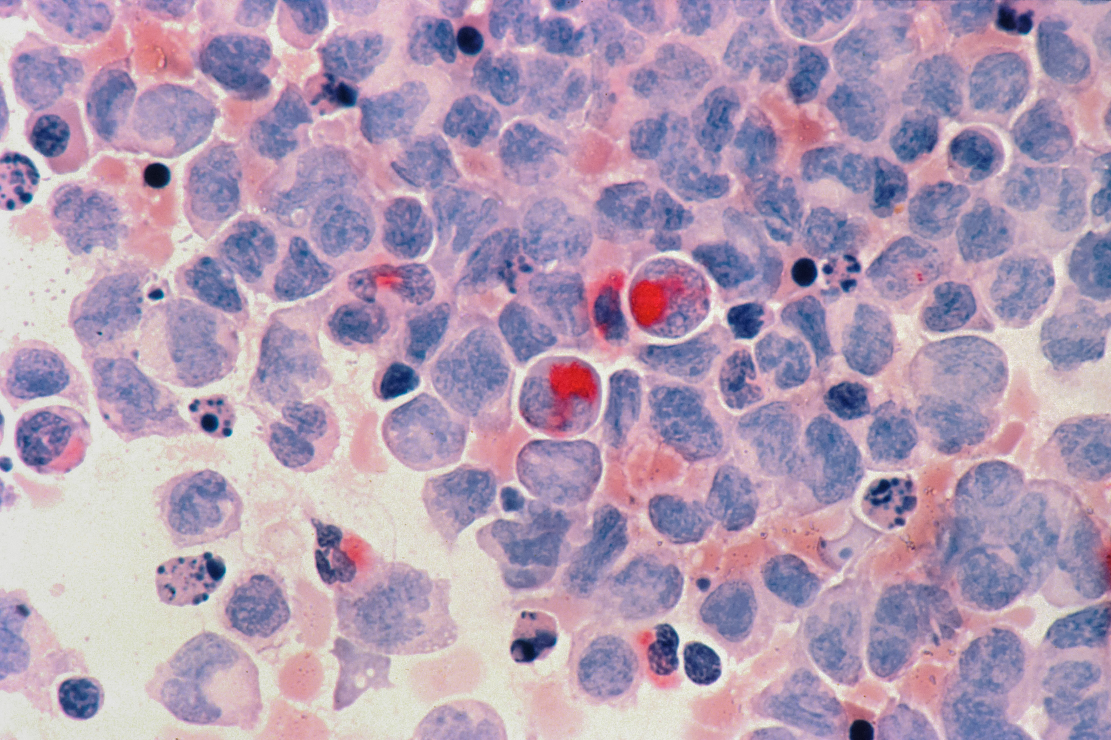
Table of Content
Problem
Project Ideation
Data Information
Data Visualization
Machine Learning Concepts
Feature Selection
Evaluation Metrices
Methodology
Results
Conclusion

Slide 3


Problem
Breast cancer is one of the most harmful diseases that negatively effects for women public health
Detecting the tumor on breast is not an easy task which is required medical technical and support from technology
Breast Cancer Detection
1

Slide 4



Project Ideation
Breast Cancer Images
Breast Cancer Data
Machine Learning Models
Breast Cancer Detection
2

Slide 5

Data Introduction
Breast Cancer Data From Kaggle
Breast Cancer Wisconsin (Diagnostic) Dataset [1] is one of the most popular dataset for predicting the input data is benign or malignant as the tumors of breast cancer.
Breast Cancer Detection
3

Slide 6
Data Introduction
Breast Cancer Data From Kaggle
569
357 benign
212 malignant
30 Features
Extract and compute from digital images of diagnosis
Rows in total
2 Labels
Benign as 0 and Malignant as 1
Breast Cancer Detection
4

Slide 7
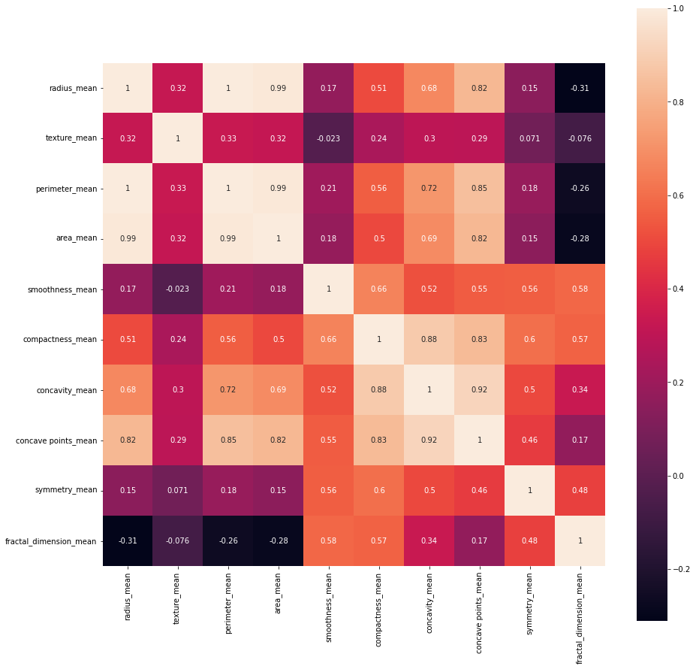
Data Visualization
Heatmap of 10 features with Seaborn
Breast Cancer Detection
5

Slide 8
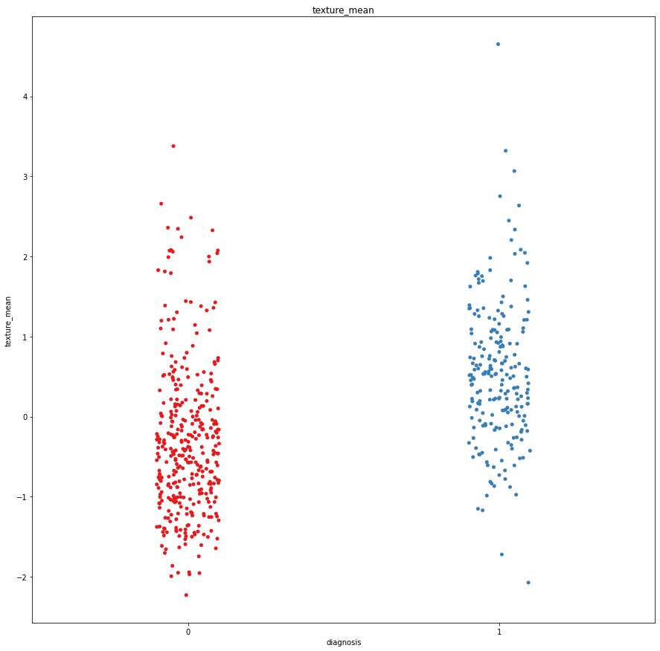
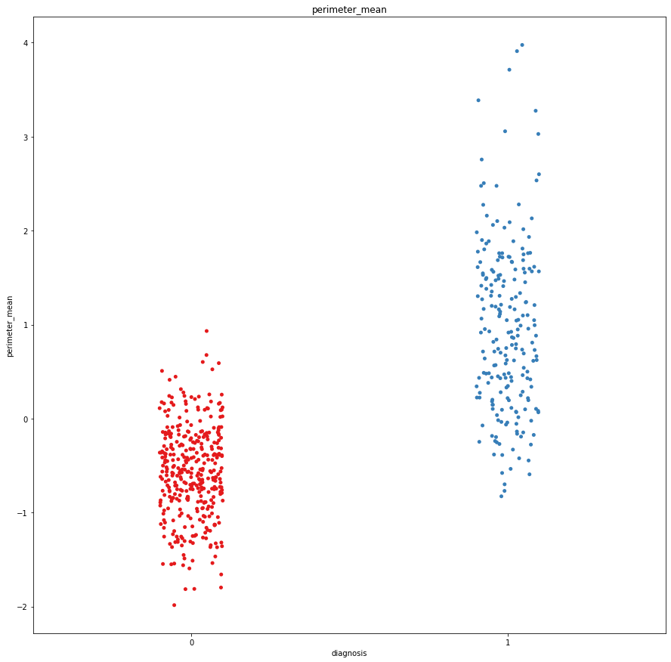
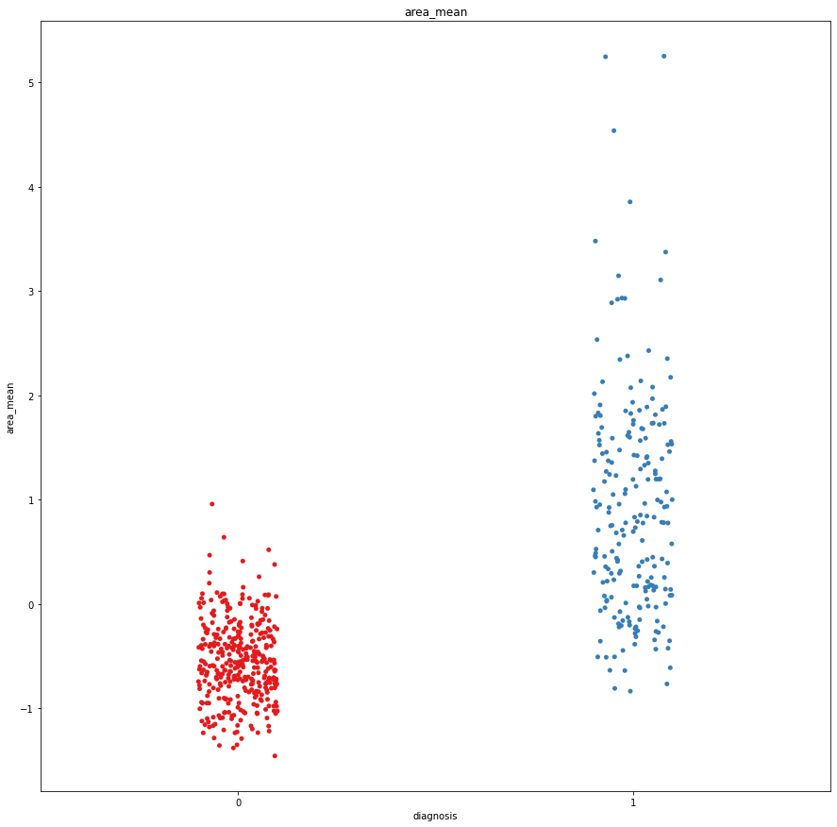
Data Visualization
Strip Plot Using Seaborn of 3 features with 2 classes
Breast Cancer Detection
6

Slide 9
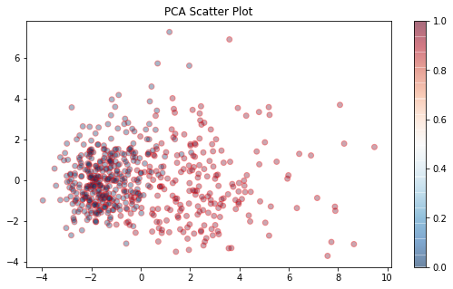
Data Visualization
Scatter Plot Using PCA by Selecting 2 Features to Represent on Graph
Breast Cancer Detection
7

Slide 10
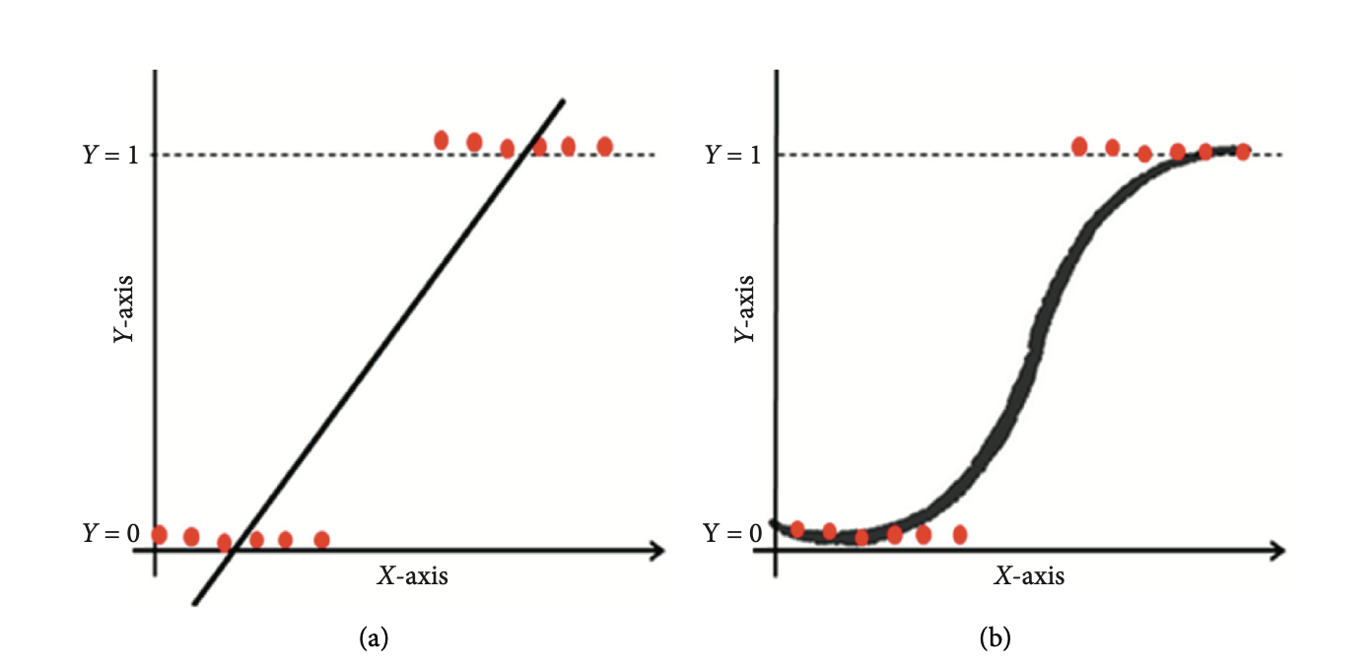
Machine Learning Concepts
Logistic Regression
Logistic Regression (LR) is a supervised learning model that forecasts binary outcomes using logistic function as the core element that can be as true or false, 1 or 0, Yes or No…
Figure: (a) Linear Regression and (b) Logistic Regression
Breast Cancer Detection
8

Slide 11
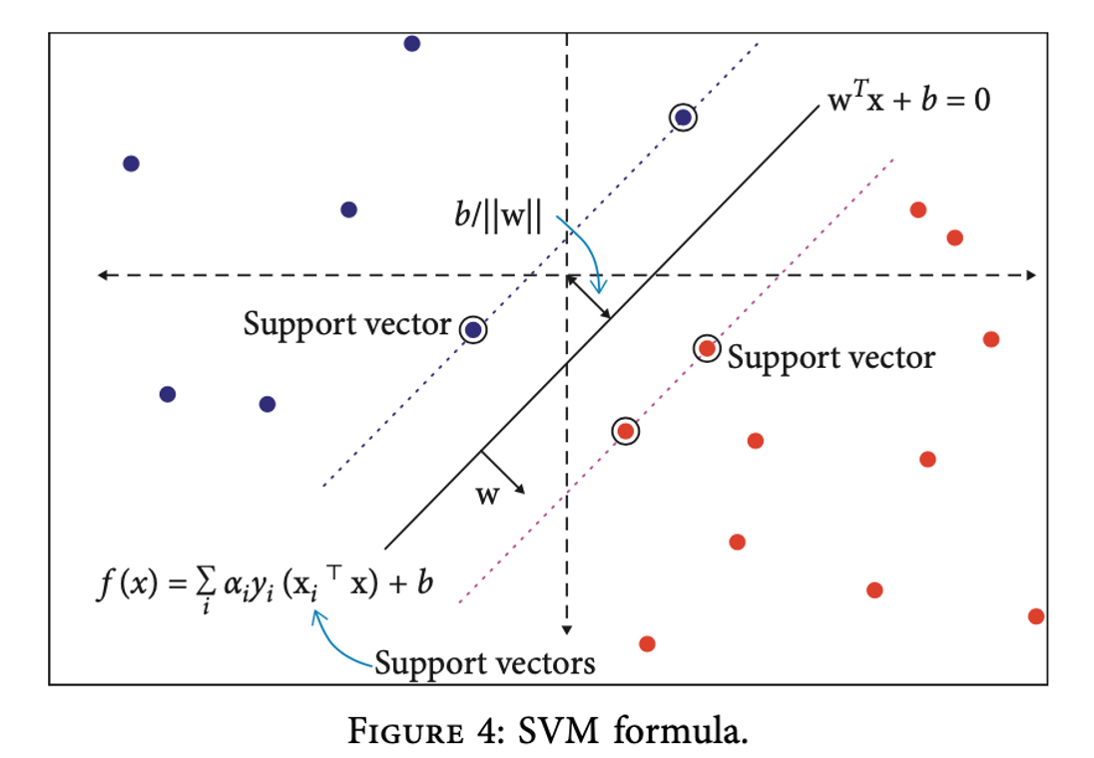
Machine Learning Concepts
Support Vector Machine
Support Vector Machine (SVM) is a machine learning algorithm that focuses on hyperplane formation that set a fair boundary for distinguishing the two different datasets.
Figure: SVM Formula
Breast Cancer Detection
9

Slide 12
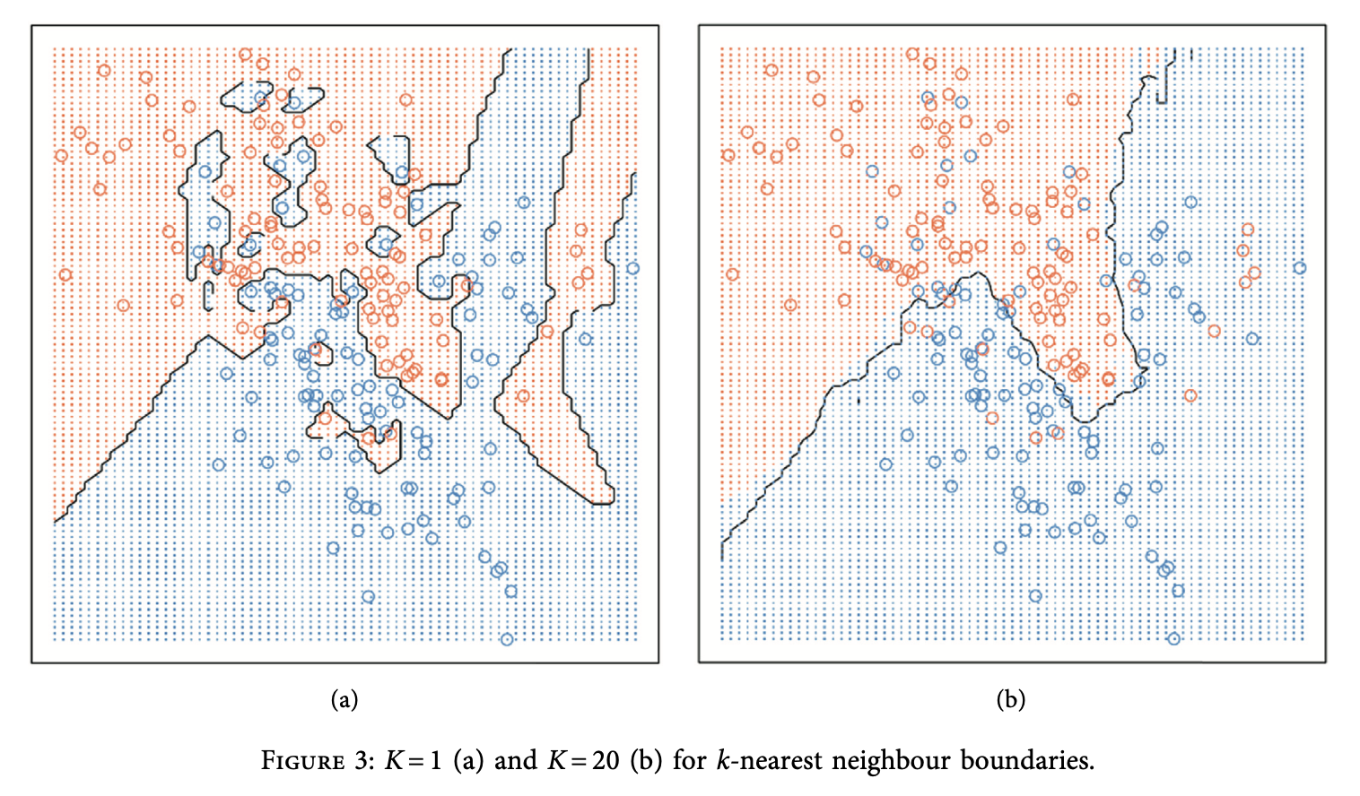
Machine Learning Concepts
K-Nearest neighbor Classifier
K-nearest neighbour is a machine learning algorithm that identifies the pattern and explores the closest or nearest relations to K.
Figure: (a) K=1 and (b) K = 20
Breast Cancer Detection
10

Slide 13
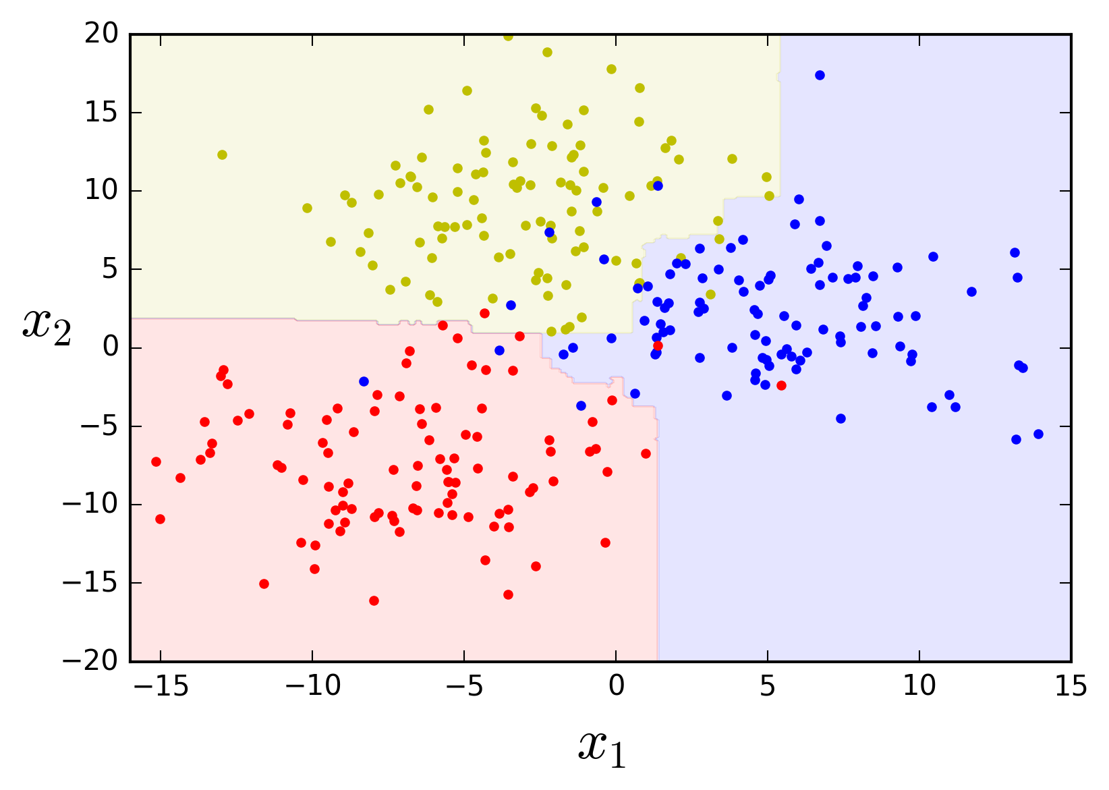
Machine Learning Concepts
Random Forest Classifier
Random Forest Classifier is a supervised learning technique follow the method to classify the large number of data with decision tree algorithm through the concept of ensemble learning.
Figure: An Example of Random Forest Classifier use case
Breast Cancer Detection
11

Slide 14
Feature Selection
Principal Component Analysis (PCA)
Principal Component Analysis is a method to reduce the dimensions follows the linear algebra for the computation.
It is useful for graph representation by reducing the parameters to only 2 parameters and feature selection use case.
Breast Cancer Detection
12

Slide 15
Evaluation Matrices
Classification Report
Accuracy: The sum of all correct predictions divides by total predictions
Recall: Focus on Ratio of True Positive correctly classified to the total number of positive (TP + FN)
Precision: Focus on Ratio of True Positive correctly classified to the total number of classified positive samples (TP + FP)
F1-Score: Combination of Recall and Precision
Breast Cancer Detection
13

Slide 16
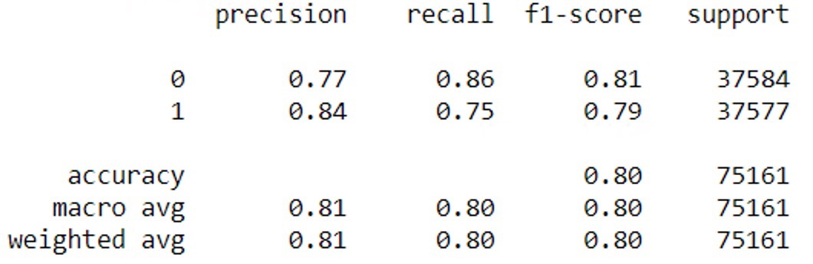
Evaluation Matrices
Example of Classification Report
Breast Cancer Detection
14

Slide 17
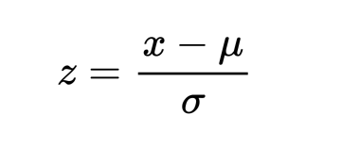
Methodology
Preprocessing
Split data into 2 main sets: Training Set for 80% and Testing Set for 20%
Using Standard Scaler for scaling the features according to this formula:
Breast Cancer Detection
15

Slide 18
Methodology
Model 1: Logistic Regression
Model 2: Logistic Regression with PCA (Features = 2)
Model 3: K-Nearest Neighbor Classifier (K = 2)
Model 4: K-Nearest Neighbor Classifier (K = 3)
Model 5: Support Vector Machine (Kernel = rbf)
Model 6: Support Vector Machine (Kernel = linear)
Model 7: Random Forest Classifier
Model 8: Random Forest Classifier with PCA (Features = 2)
Breast Cancer Detection
16

Slide 19
Result
Output with Testing Set
Model 1 | Model 2 | Model 3 | Model 4 | Model 5 | Model 6 | Model 7 | Model 8
97.37% | 92.98% | 93.86% | 94.74% | 98.25% | 96.46% | 93.86% | 92.98%
Support Vector Machine (Kernel = rbf)
Breast Cancer Detection
17

Slide 20
Conclusion
Cleaning Data is one of the most important steps to reach the maximum results from visualization to data prediction
Understand on how to do preprocessing and visualization
Successfully implemented the models and evaluation them
Apply dimensionality reduction on the models and would be benificial in the long run dealing with large amounts of features
Clearly identify the algorithms and how to use them
Boost the creativity and customization to adjust the right use case
Breast Cancer Detection
18

Slide 21
References
Breast Cancer Wisconsin (Diagnostic) Data Set. (n.d.). Retrieved July 6, 2022, from https://www.kaggle.com/datasets/uciml/breast-cancer-wisconsin-data
Alanazi, S. A., Kamruzzaman, M. M., Islam Sarker, M. N., Alruwaili, M., Alhwaiti, Y., Alshammari, N., & Siddiqi, M. H. (2021). Boosting Breast Cancer Detection Using Convolutional Neural Network. Journal of Healthcare Engineering, 2021, e5528622. https://doi.org/10.1155/2021/5528622
Brownlee, J. (2016, March 31). Logistic Regression for Machine Learning. Machine Learning Mastery. https://machinelearningmastery.com/logistic-regression-for-machine-learning/
Christopher, A. (2021, February 3). K-Nearest Neighbor. The Startup. https://medium.com/swlh/k-nearest-neighbor-ca2593d7a3c4
Yiu, T. (2021, September 29). Understanding Random Forest. Medium. https://towardsdatascience.com/understanding-random-forest-58381e0602d2
Gandhi, R. (2018, July 5). Support Vector Machine — Introduction to Machine Learning Algorithms. Medium. https://towardsdatascience.com/support-vector-machine-introduction-to-machine-learning-algorithms-934a444fca47
Data simple - Random Forests. (n.d.). Retrieved July 12, 2022, from http://luisvalesilva.com/datasimple/random_forests.html
Breast Cancer Detection
20

Slide 22
THANK YOU!

